Slide 1


Intermediate Python
Module Coding Basics

Slide 2
Module Coding Basics – Overview
Creating and organizing Python modules
Different ways to import modules
How import execution works
Understanding module namespaces
Reloading modules during development
Code Example
import my_module
Notes:
Explain that this session moves from concepts to hands-on coding. Emphasize that learners will now control how modules are created and imported.

Slide 3
Module Creation & Filenames
Each .py file is a module
Filename becomes module name
Must be valid Python identifier
Avoid name conflicts
Keep names lowercase
Code Example
math_utils.py → import math_utils
Notes:
Warn students not to name files like math.py or random.py, as they can override standard library modules.

Slide 4
Import Styles – Overview
Code Example
import math
from math import sqrt
from math import *
Python supports multiple import styles
Each style affects namespace differently
Choice impacts readability
Improper use causes bugs
Follow best practices
Notes:
Set the stage—this slide introduces import styles, the next slides go deep into each one.

Slide 5
import module
Imports entire module
Requires module prefix
Clear and explicit
Preferred in most cases
Avoids name collisions
Code Example
import math
print(math.sqrt(9))
print(math.pi)
Notes:
Explain why this style is safest and most readable, especially in large codebases.

Slide 6
Reloading Modules (importlib.reload)
Used during development
Reloads modified module code
Requires importlib
Does not reset all state
Not for production use
Code Example
import my_module
import importlib
importlib.reload(my_module)
Notes:
Explain why reload is helpful in interactive shells and why restarting the program is safer in real applications

Slide 7
Import Execution Rules
Code Example
# demo.py
print("Module loaded")
# main.py
import demo
import demo
Module code runs on first import
Subsequent imports use cache
Execution is top-to-bottom
Global code executes immediately
Controlled with if __name__ == "__main__"
Notes:
Explain side effects of imports and why executable code should be guarded.

Slide 8
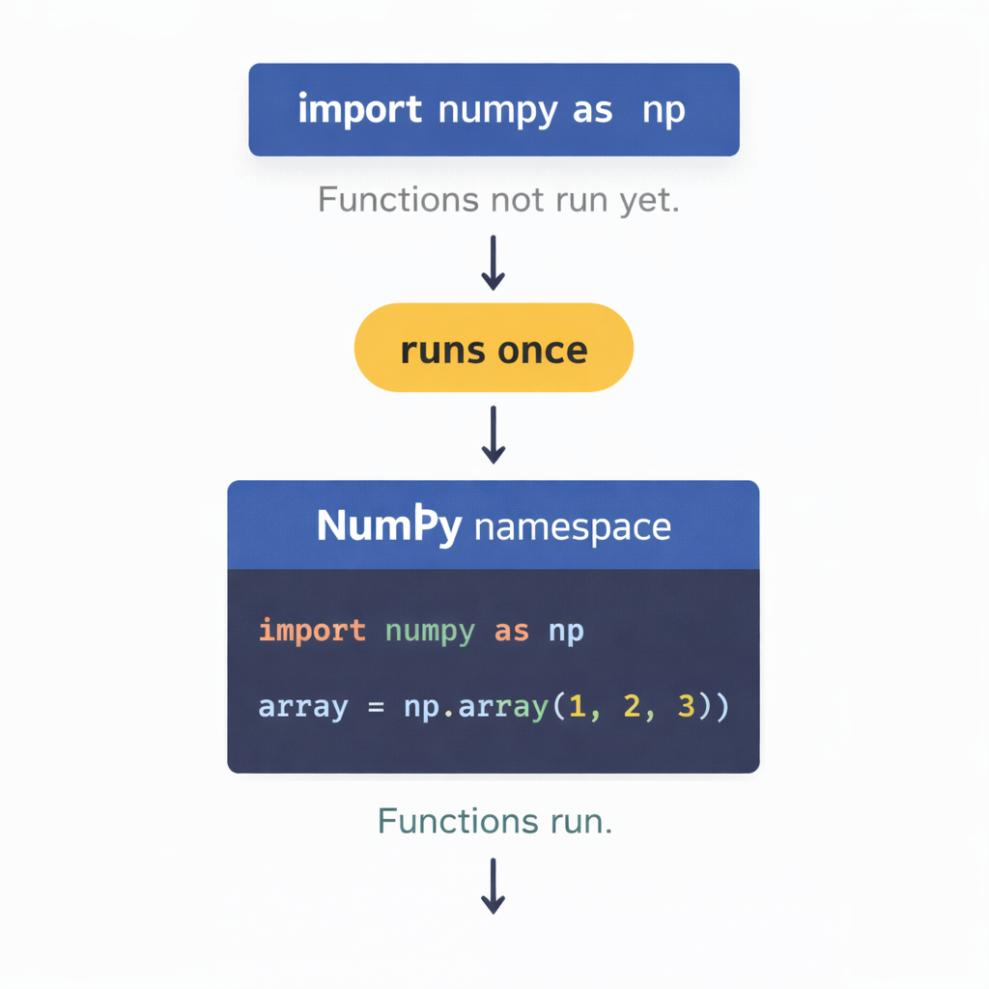

Slide 9
Module Namespaces
Code Example
import math
import random
print(math.pi)
print(random.randint(1, 5))
Each module has its own namespace
Names do not leak automatically
Accessed using dot notation
Prevents name collisions
Improves code clarity
Notes:
Use the analogy of “rooms” or “containers” to explain namespaces.

Slide 10
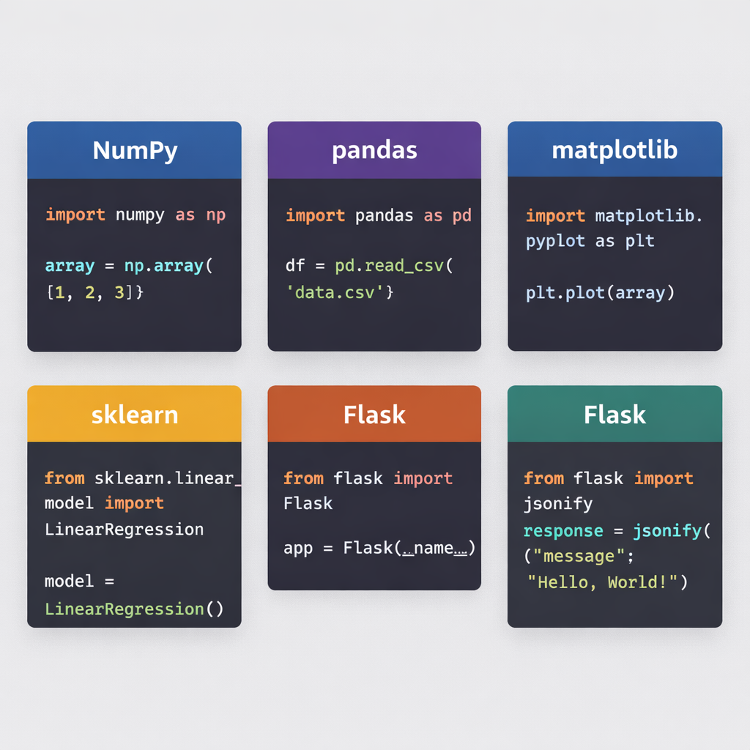

Slide 11
from module import name
Imports specific attributes
No module prefix required
Shorter and cleaner syntax
Can improve readability
Risk of name conflicts
Code Example
from math import sqrt, pi
print(sqrt(9))
print(pi)
Notes:
Explain when this style is useful—small scripts or frequently used functions.

Slide 12
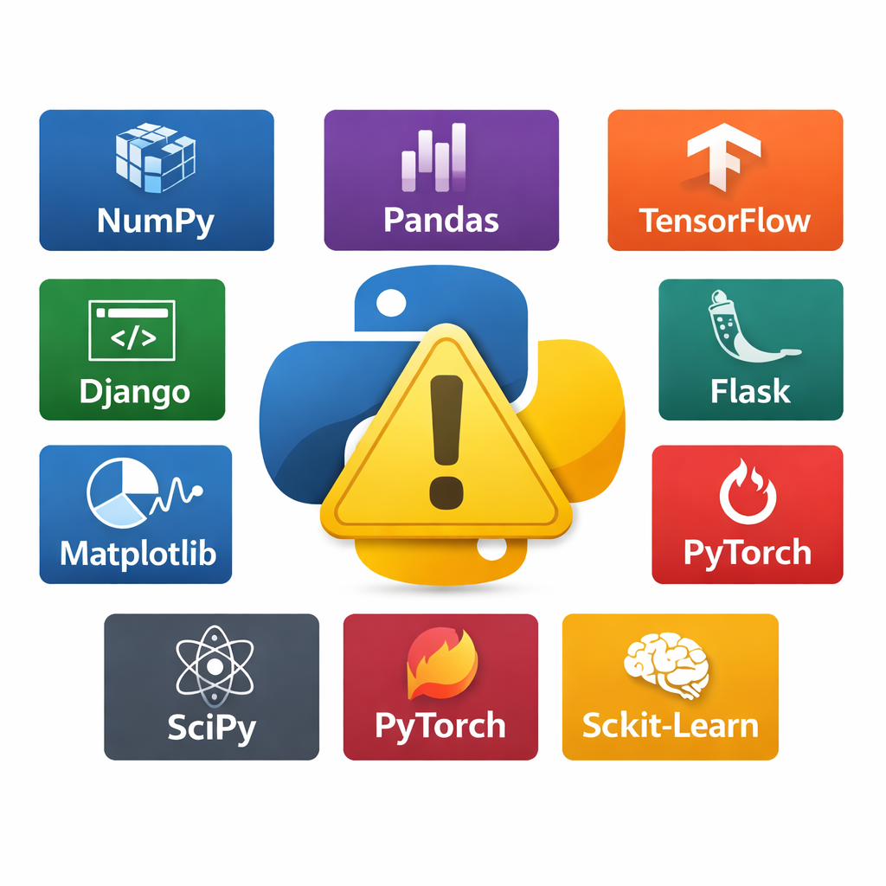
from module import *
Imports all public names
Pollutes namespace
Hard to trace origins
Discouraged in production code
Common in interactive sessions
Code Example
from math import *
print(sqrt(16))
Notes:
Strongly caution students. Explain debugging difficulties and why professionals avoid this style.

Slide 13
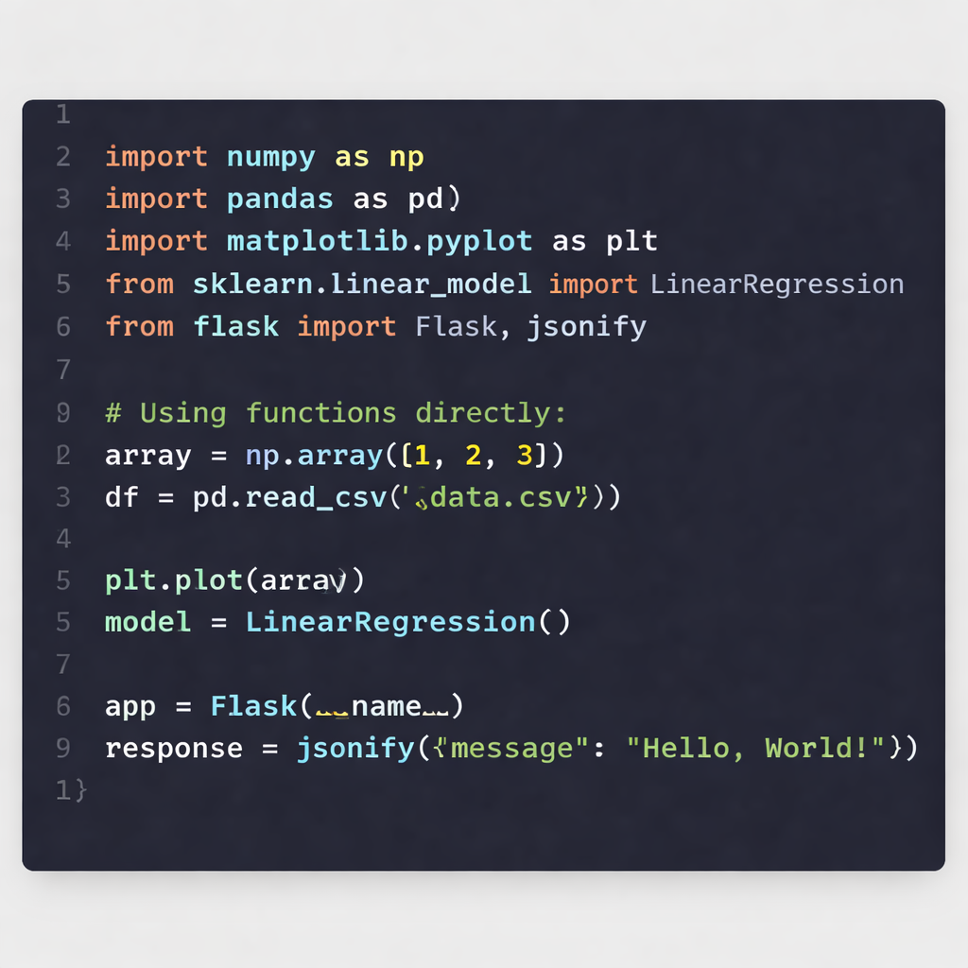

Slide 14
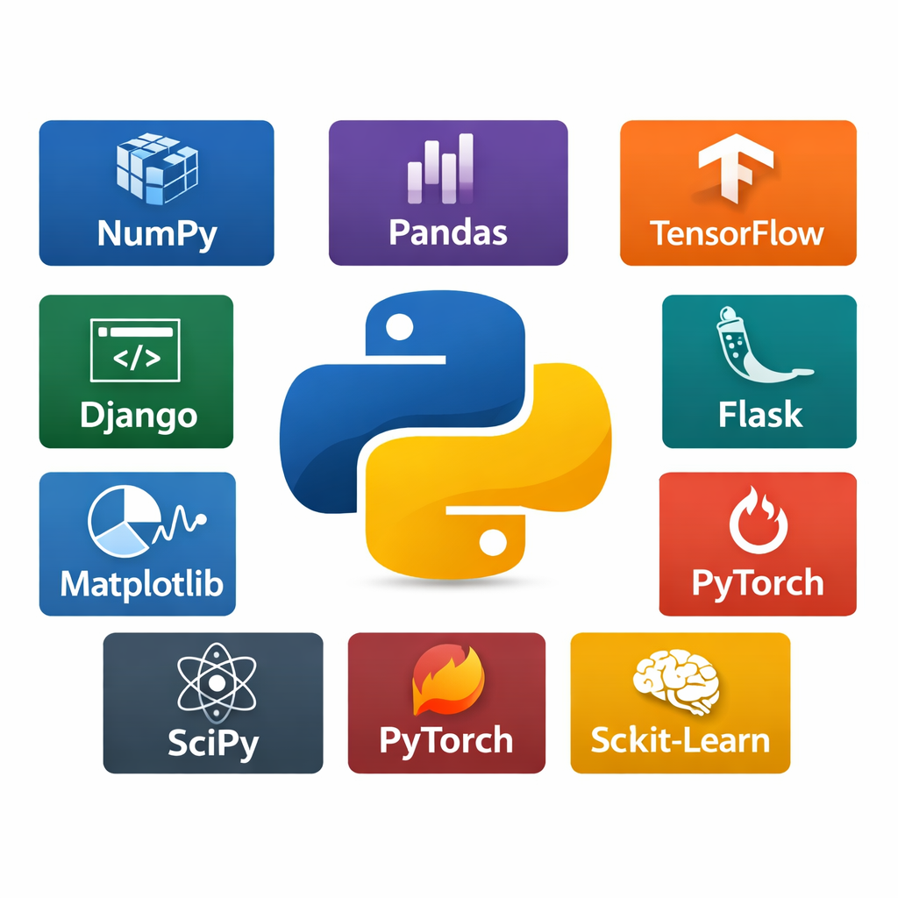
Session Summary – Module Coding Basics
Modules are created using .py files
Multiple import styles exist
Imports execute code once
Namespaces prevent conflicts
Reloading helps during development
Code Example
import this
Notes:
Reinforce best practices: clear filenames, explicit imports, and avoiding wildcard imports.

